Slide 1
Planning
Chapter 10,
Artificial Intelligence, based on AIMA Slides c Stuart Russel and Peter Norvig,
Chapter 10, Sections 1–4
1

Slide 2
Outline
Action Planning as AI problem
Planning Domain Definition Language (PDDL)
Forward and backward state-space search
GraphPlan
SatPlan
Partial order planning
Chapter 10, Sections 1–4
2

Slide 3
Action Planning as an AI problem
Action planning is needed in many AI systems
Autonomous agents which demonstrate intelligent behaviour (robots, drones, driverless vehicles, etc.)
AI programs which automate rational thinking (theorem provers, expert systems, schedulers, NLP systems, etc.)
Hybrid systems which extend the human ability to operate in hostile environment (surgical devices, underwater video cameras, etc.)
Planning research has been central to AI from the beginning, partly because of practical interest but also because of the “intelligence” features of human planners.
Large logistics problems, operational planning, robotics, scheduling etc.
A number of international Conferences on Planning
Bi-annual Planning competition
Chapter 10, Sections 1–4
3

Slide 4
Automated Planning
The setting: a single agent in a fully observable, deterministic and static environment.
Propositional logic can express small domain planning problems, but becomes impractical if there are many actions and states (combinatorial explosion).
Example: In the wumpus world the action of a forward-step has to be written for all four directions, for all n₂ locations, and for each time step T .
The Planning Domain Definition Language (PDDL) is a subset of First-Order Predicate Logic (FOL) which is more expressive than propositional logic. It allows for more detailed representation of the states.
Chapter 10, Sections 1–4

Slide 5
Planning Domain Definition Language (PDDL)
PDDL is derived from the planning language of Stanford Research Institute Problem Solver (STRIPS).
Initial and goal states s, described using predicates over state variables.
A set of Actions(s) described in terms of their preconditions and effects on the states.
Closed world assumption principle (CWA): Unmentioned state variables are assumed false.
Example:
Action: Fly(from, to)
Precondition: At(p, from), Plane(p), Airport(from), Airport(to)
Effect: ¬At(p, from), At(p, to)
Chapter 10, Sections 1–4
5

Slide 6
PDDL/STRIPS operators
Actions descriptions arranged in a separate module
Action: predicates with parameters
Precondition: conjunction of positive literals
Effect: conjunction of literals
Example:
At(p) Sells(p,x)
Action: Buy(x)
Precondition: At(p), Sells(p, x)
Effect: Have(x)
Buy(x)
Have(x)
Restricted language for describing the states using unary and binary predicates
Restricted language ⇒ efficient algorithm
A complete set of STRIPS operators can be translated into a set of axioms describing the successor-state
The solution of the planning problem (the plan) is a sequence of actions leading to the goal state from an initial state
Chapter 10, Sections 1–4

Slide 7
Example: Planning air cargo transport
A classical transportation problem: Loading and unloading cargo and flying between different airports.
Actions: Load(cargo, plane, airport), Unload(cargo, plane, airport), Fly(plane, airport, airport)
Predicates: In(cargo, plane), At(cargo, airport), At(plane, airport)
Plan:
Load(C1, P1, SFO), Fly(P1, SFO, JFK), Unload(C1, P1, JFK), Load(C2, P2, JFK), Fly(P2, JFK, SFO), Unload(C2, P2, SFO).
Chapter 10, Sections 1–4

Slide 8
Example: Planning in the blocks world
Cube-shape blocks sitting on a table or stacked on top of each other.
Actions: PutOn(block, block), PutOnTable(block)
Predicates: On(block, block), On(block, table), Clear(block),
Clear(table)
Plan for reversing the order of two blocks: PutOn(B2,T), PutOn(B1,B2)
Chapter 10, Sections 1–4

Slide 9
How difficult is planning?
Does there exist a plan that achieves the goal? PlanSat
Does there exist a solution of length at most k? Bounded PlanSat PlanSat and Bounded PlanSat are PSPACE-complete.
i.e., difficult!
PlanSat without negative preconditions and without negative effects is in P (proportional).
i.e., solveable!
Chapter 10, Sections 1–4
9

Slide 10
State-space search
Forward (progression):
Starts the search for actions from the current state and plans subsequent actions towards the goal state
Considers all actions that are applicable in a given state (too much unnecessary searches)
Backward (regression):
Starts the search for actions from the goal state and plans the previous actions from the initial state
Considers only actions that are relevant (more efficient)
Neither of them is efficient without good heuristics!

Slide 11
Heuristics for forward state-space search
For forward state-space search there are a number of domain-independent heuristics:
Relaxing actions:
Ignore-preconditions heuristic
Ignore-delete-lists heuristic
Using state abstractions:
Reduce the state space by considering only more general states rather than all states
Programs that has won the bi-annual Planning competition has often used
fast forward search with heuristics (FF), or
planning graphs (GraphPlan), or
constraint-satisfaction planners (SAT).

Slide 12
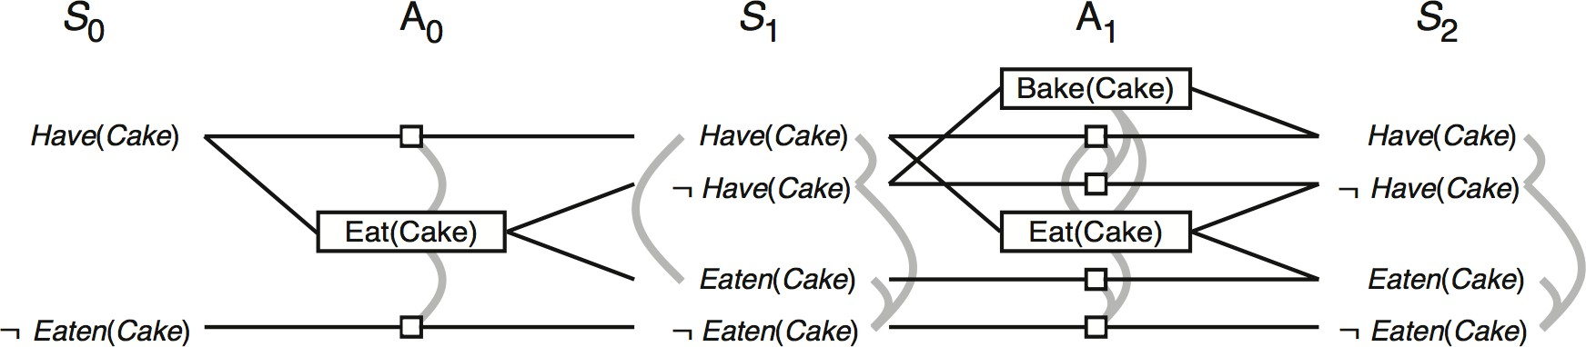
Planning graphs
The main disadvantage of state-space search is the size of the search tree (exponential). Also, the heuristics are not admissible in general.
The planning graph is a polynomial size approximation of the complete tree. Search on this graph is an admissible heuristic.
The planning graph is organized in alternating levels of possible states S_{i} and applicable actions A_{i}. Links between levels represent preconditions and effects whereas links within the levels express conflicts (mutex-links).

Slide 13
Mutex links within the planning graph
Mutex links between actions
Inconsistent effects: one action negates an effect of the other. For example, Eat (Cake) and the persistence of Have(Cake) have inconsistent effects because they disagree on the effect Have(Cake).
Interference: one of the effects of one action is the negation of a precondition of the other. For example Eat (Cake) interferes with the persistence of Have(Cake) by negating its recondition.
Competing needs: one of the preconditions of one action is mutually exclusive with a precondition of the other. For example, Bake(Cake) and Eat (Cake) are mutex because they compete on the value of the Have(Cake) precondition
Mutex links between states
Inconsistent support: one literal is the negation of the other or each possible pair of actions that could achieve the two literals is mutually exclusive

Slide 14
Planning Problem
A planning problem with l literals and a actions has a polynomial size plan ning graph:
Levels S_{i} contain at most l nodes and l² mutex links
Levels A_{i} contain at most a + l nodes and (a + l)² mutex links
At most 2(al + l) links between levels for preconditions and effects
Therefore, a graph with n levels has size O(n(a + l)²)

Slide 15
The GraphPlan algorithm
The GraphPlan algorithm expands the graph with new levels S_{i} and A_{i} until there are no mutex links between the goals.
To extract the actual plan, the algorithm searches backwards in the graph.
The plan extraction is the difficult part and is usually done with greedy-like heuristics.

Slide 16
SatPlan and CSP
Translate the PDDL description into SAT or CSP (constraint satisfaction problem).
The goal state as well as all actions have to be propositionalized.
Action schemas have to be replaced by a set of ground actions
Variables have to be replaced by constants
Fluents need to be introduced for each time step, etc.
⇒ combinatorial explosion
In other words, we remove a part of the benefits of the expressiveness of PDDL to gain access to efficient solution methods for CSP solvers.

Slide 17
Historical remark: Linear planning
Planners in the early 1970s considered totally ordered action sequences
problems were decomposed in subgoals
the resulting subplans were stringed together in some order
this is called linear planning
But, linear planning is incomplete!
there are some very simple problems it cannot handle due to interaction between goals (i.e., Sussman anomaly)
a complete planner must be able to interleave subplans and thus, to modify the subgoals
Partial-order planning, state-of-the-art during the 1980s and 90s
today mostly used for specific tasks, such as operations scheduling
also used when it is important for humans to understand the plans - e.g., operational plans for spacecraft and Mars rovers are checked by human operators before uploaded to the vehicles

Slide 18
Example: The Sussman anomaly
"Sussman anomaly" problem
A
B
C
C
B
A
Start State
Goal State
Start State:
Clear(x) On(x,z) Clear(y)
Clear(x) On(x,z)
PutOn(x,y)
PutOnTable(x)
~On(x,z) ~Clear(y) Clear(z) On(x,y)
~On(x,z) Clear(z) On(x,Table)
Goal State: On(A,B) On(B,C)
Artificial Intelligence, spring 2013, Peter Ljungl¨of; based on AIMA Slides c Stuart Russel and Peter Norvig, 2004
Chapter 10, Sections 1–4
17

Slide 19
Example contd.
START
C
B A
On(C,A) On(A,Table) Cl(B) On(B,Table) Cl(C)
On(A,B) On(B,C)
A
FINISH
B
C

Slide 20
Example contd.
START
C
B A
On(C,A) On(A,Table) Cl(B) On(B,Table) Cl(C)
Cl(B) On(B,z) Cl(C) On(C,y)
PutOn(B,C)
On(A,B) On(B,C)
A
FINISH
B
C

Slide 21
Example contd.
START
C
B A
On(C,A) On(A,Table) Cl(B) On(B,Table) Cl(C)
PutOn(A,B) clobbers Cl(B)
=> order after PutOn(B,C)
Cl(B) On(B,z) Cl(C)
Cl(A) On(A,z) Cl(B)
PutOn(B,C)
PutOn(A,B)
On(A,B) On(B,C)
A
FINISH
B
C

Slide 22
Example contd.
START
C
B A
On(C,A) On(A,Table) Cl(B) On(B,Table) Cl(C)
PutOn(A,B) clobbers Cl(B)
=> order after PutOn(B,C)
On(C,z) Cl(C)
PutOnTable(C)
PutOn(B,C) clobbers Cl(C)
=> order after PutOnTable(C)
Cl(B) On(B,z) Cl(C)
Cl(A) On(A,z) Cl(B)
PutOn(A,B)
PutOn(B,C)
On(A,B) On(B,C)
A
FINISH
B
C

Slide 23
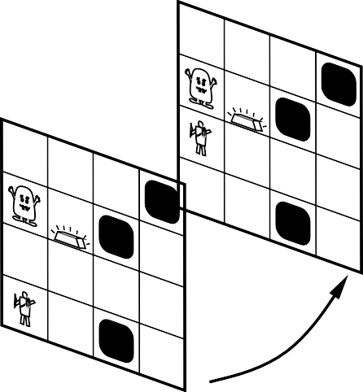
Situation Calculus to keep track of the changes
Facts hold in situations, rather than eternally
Example: Holding(Gold, Now) rather than just Holding(Gold)
Situation calculus is one way to represent change in FOL by adding a situation argument to each non-eternal predicate
Example: Now in Holding(Gold, Now) denotes a situation
Situations are connected by the Result function, where Result(a, s) is the situation that results from doing action a in s
PIT
Gold
PIT
PIT
PIT
Gold
PIT
S₁
PIT
Forward
S
0

Slide 24
Problems with the action descriptions
“Effect” axiom—describe changes due to action
∀ s AtGold(s) ⇒ Holding(Gold, Result(Grab, s))
“Frame” axiom—describe non-changes due to action
∀ s HaveArrow(s) ⇒ HaveArrow(Result(Grab, s))
Frame problem: find an elegant way to handle non-change
representation—avoid frame axioms
inference — avoid repeated “copy-overs” to keep track of state
Qualification problem: true descriptions of real actions require endless caveats — what if gold is slippery or nailed down or . . .
Ramification problem: real actions have many secondary consequences — what about the dust on the gold, wear and tear on gloves, . . .

Slide 25
Solution to the frame problem
Successor-state axioms solve the representational frame problem
Each axiom is “about” a predicate (not an action per se):
P true afterwards
⇔ [an action made P true
∨ P true already and no action made P false]
Example: For holding the gold we have the following
∀ a, s Holding(Gold, Result(a, s)) ⇔
(a = Grab ∧ AtGold(s)) ∨ (Holding(Gold, s) ∧ a = Release)
Different solutions are also possible in different languages and theories (i.e., default logic, circumscription, description logic, etc.)

Slide 26
Planning in Situation Calculus theory
Initial condition in KB:
At(Agent, [1,1], S₀)
At(Gold, [1,2], S₀)
Query:
Ask(KB, ∃ s Holding(Gold, s))
i.e., in what situation will I be holding the gold?
Answer: {s/Result(Grab, Result(F orward, S₀))}
i.e., go forward and then grab the gold!
This assumes that the agent is interested in plans starting at S₀ and that S₀ is the only starting situation described in the KB

Slide 27
A better way: Order the actions
Represent plans as action sequences [a₁, a₂, . . . , a_{n}] and PlanResult(p, s) the result of executing p in s
Then the query
Ask(KB, ∃ p Holding(Gold, PlanResult(p, S₀)))
has the solution
{p/[F orward, Grab]}
Definition of PlanResult in terms of Result:
∀ s PlanResult([ ], s) = s
∀ a,p,s PlanResult([a|p], s) = PlanResult(p, Result(a, s))
Planning systems are special-purpose reasoners designed to do this type of inference more efficiently than a general-purpose reasoner

Slide 28
Planning and Acting
in Non-Deterministic World
Chapter 11, Section 3
Artificial Intelligence, ased on AIMA Slides c Stuart Russel and Peter Norvig,
Chapter 11, Section 3
1

Slide 29
Outline
The real world
Sensorless/contingent planning (Conditional Planning)
Conditional Planning
Continuous planning (Execution Monitoring and Replanning)

Slide 30


The real world
Inflating a tire problem
On(x) ~Flat(x)
START
FINISH
~Flat(Spare) Intact(Spare) Off(Spare) On(Tire1) Flat(Tire1)
On(x)
Off(x) ClearHub
Intact(x) Flat(x)
Remove(x)
Puton(x)
Inflate(x)
Off(x) ClearHub
On(x) ~ClearHub
~Flat(x)

Slide 31
Things go wrong
Incomplete information
Unknown preconditions, e.g., Intact(Spare)?
Disjunctive effects, e.g., Inflate(x) causes
Inflated(x) ∨ SlowHiss(x) ∨ Burst(x) ∨ BrokenPump ∨ . . .
Incorrect information
Current state incorrect, e.g., spare NOT intact Missing/incorrect postconditions in operators
Qualification problem:
can never finish listing all the required preconditions and possible conditional outcomes of actions

Slide 32
Solutions
Conformant or sensorless planning: Devise a plan that works regardless of state or outcome, considering all eventualities
Such plans may not exist
Conditional planning: Plan to obtain information (observation actions), Subplan for each contingency, e.g.,
Check(Tire1);
if Intact(Tire1)
then Inflate(Tire1)
else CallAAA…
Expensive because it plans for many unlikely cases
Continuous planning/Replanning: Assume normal states and outcomes, Check the progress during execution, replan if necessary
Unanticipated outcomes may lead to failure (e.g., no AAA card)
Really need a combination for likely/serious eventualities, as they may eventually happen

Slide 33
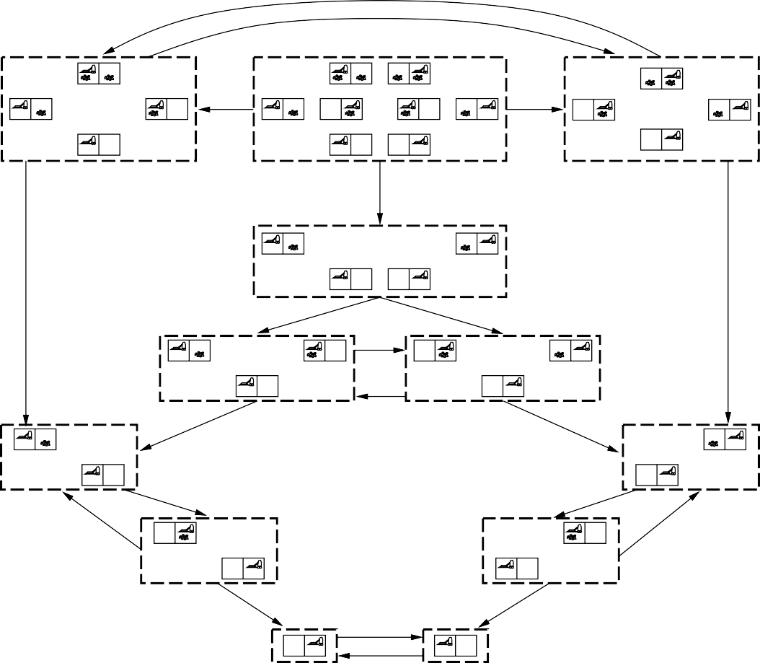
Conformant planning
Search in space of belief states instead of state space (sets of possible states)
L
R
L
R
S
S
L
R
S
R
L
S
S
R
L
L
R
S
S
R
L

Slide 34
Conformant planning contd.
Computationally may take too long – not suitable for real time planning due to the time constraints
Such plans may not exist – not suitable for complex tasks with narrow use
Too costly – not suitable for small budgets

Slide 35














Conditional planning
If the world is nondeterministic or partially observable then percepts usually provide information, i.e., split up the belief state
ACTION
PERCEPT

Slide 36
Conditional planning contd.
Conditional plans check (any consequence of KB +) percept
[. . . , if Condition then Plan_{A} else Plan_{B}, . . .]
Need some plan for every possible percept
Examples: game playing with some response for every opponent move
Algorithms:
backward chaining with additional rule which guarantees that every premise is satisfied
AND–OR tree search where all perceptions form AND branches (very similar to backward chaining algorithm)

Slide 37











Example
Double Murphy: sucking or arriving may dirty a clean square
8
Left
Suck
7
3
8
6
GOAL
Right
Suck
LOOP
Left
Suck
4
2
7
5
1
8
GOAL
LOOP

Slide 38
Example
Introducing context of the actions by conditional effect
Action(Suck,
Pecondition: AtL or AtR;
Effect: when AtL: CleanL ∧ when AtR: CleanR)
Affect the complexity of the language and require more complex planning algorithm

Slide 39
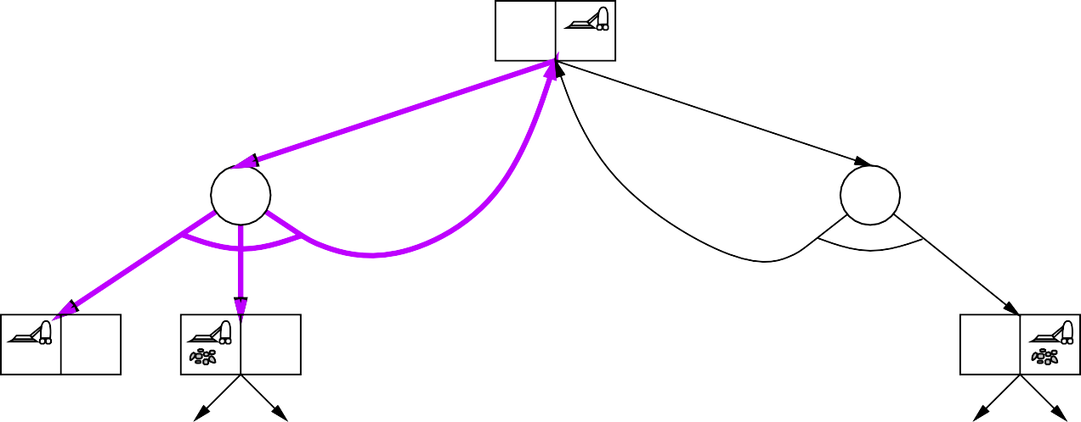
Example
Triple Murphy: also sometimes stays put instead of moving
8
Left
Suck
7
3
6
GOAL

Slide 40
Example
Introducing loops turns the tree into acyclic graph
[L₁ : Left, if AtR then L₁ else [if CleanL then [ ] else Suck]]
or [while AtR do [Left], if CleanL then [ ] else Suck]
May lead to infinite loops but they can be broken eventually

Slide 41
Execution Monitoring and Replanning
Current plan failure when preconditions of remaining plan not met
Preconditions of remaining plan
= all preconditions of remaining steps not achieved by remaining steps
= all causal links crossing current time point makes it impossible to continue the plan
On failure, replan to achieve open conditions from current state
IPEM (Integrated Planning, Execution, and Monitoring):
keep updating Start to match current state
links from actions replaced by links from Start when done

Slide 42
Structural Patterns and Historical Learning
Monitoring the goals, the plans and the outcomes allows to change the planning upon failure (learning by doing)
Sequencing
Branching
Overlapping
Repetition
Accounting the experience leads to formulating meta-concepts and meta-rules which modify the planning algorithm

